Slide 1
ROAM: Room Occupancy and Activity Monitoring
DESE71003 Sensing and Internet of Things
Zyque So Zhao-Qi
01949369

Slide 2
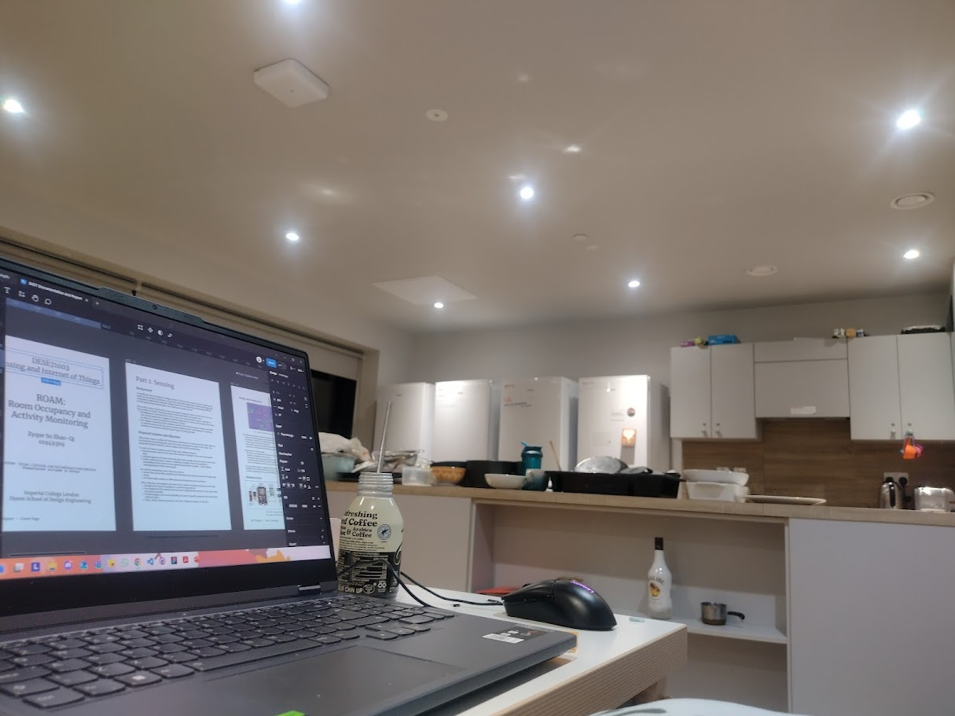
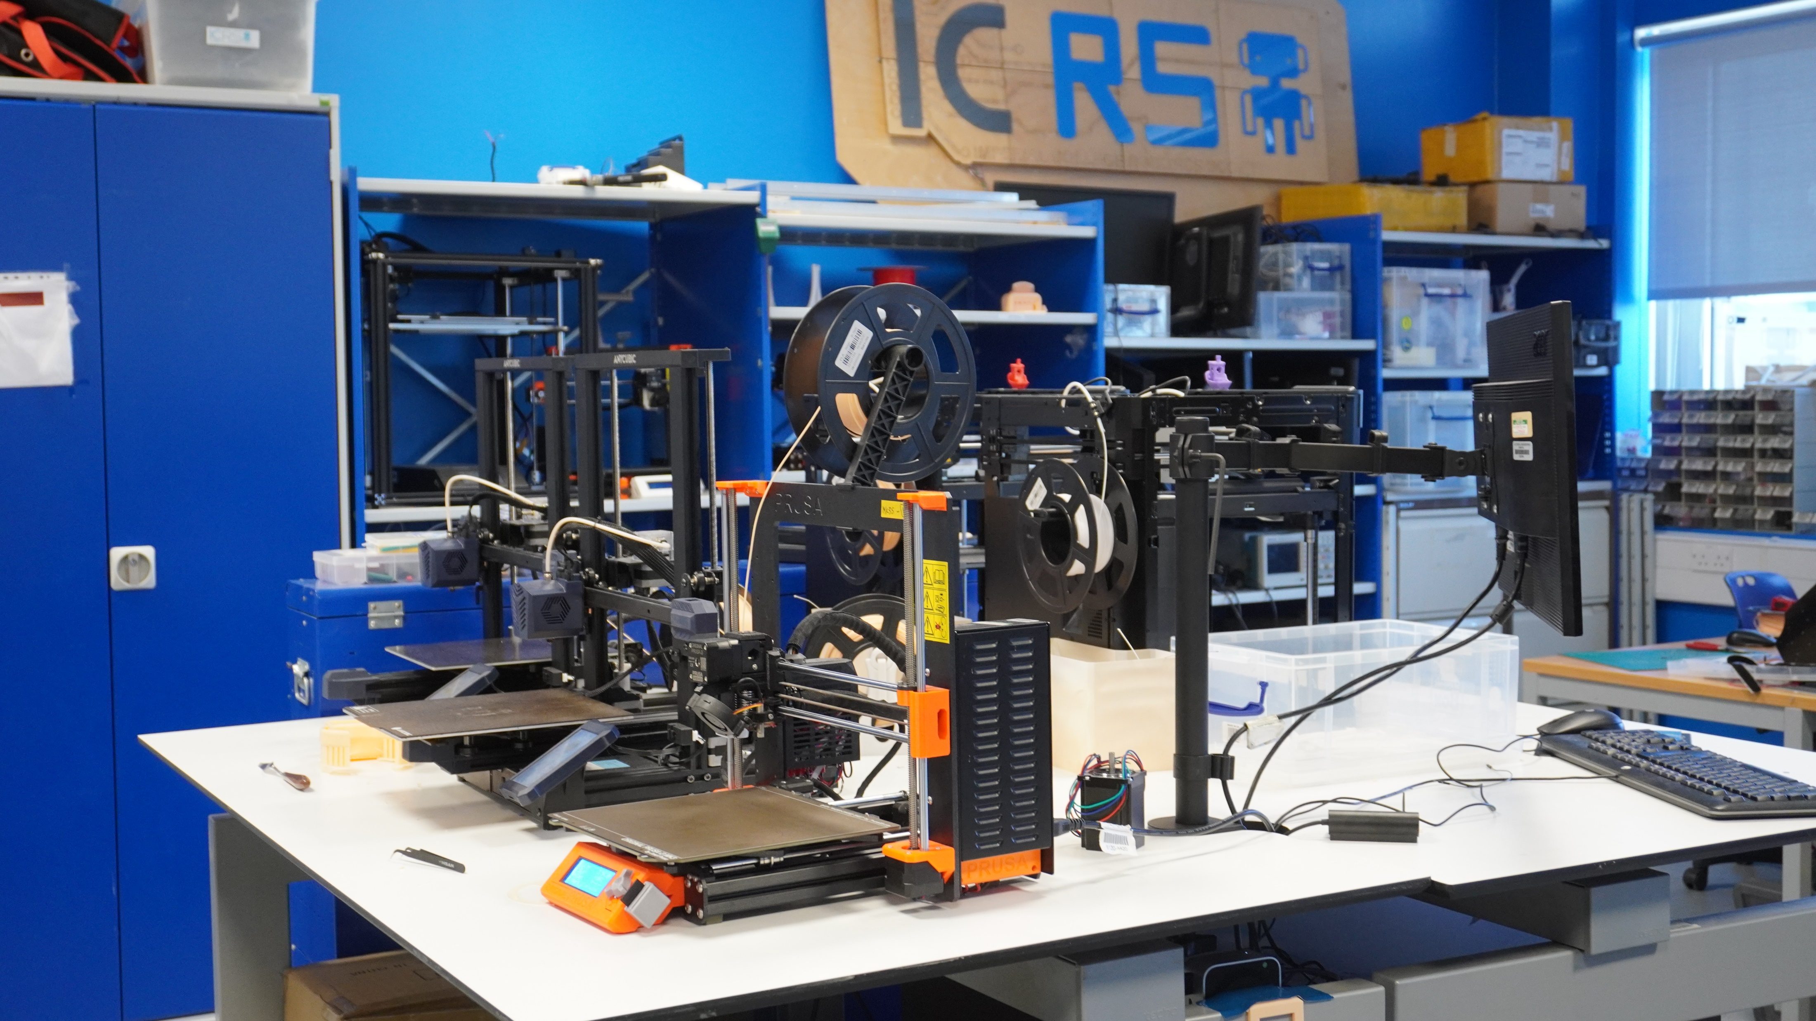
Problem
Shared student accommodation kitchen
(~15 people)
Robotics Society Lab

Slide 3




Objectives
Occupancy Monitoring
Data Analysis
Activity Classification
Soft Actuation: Communication

Slide 4
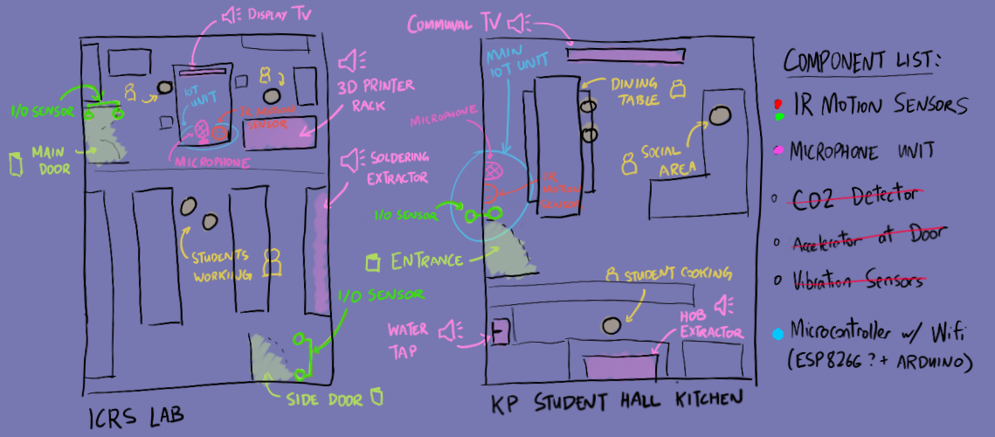
Design and plan

Slide 5
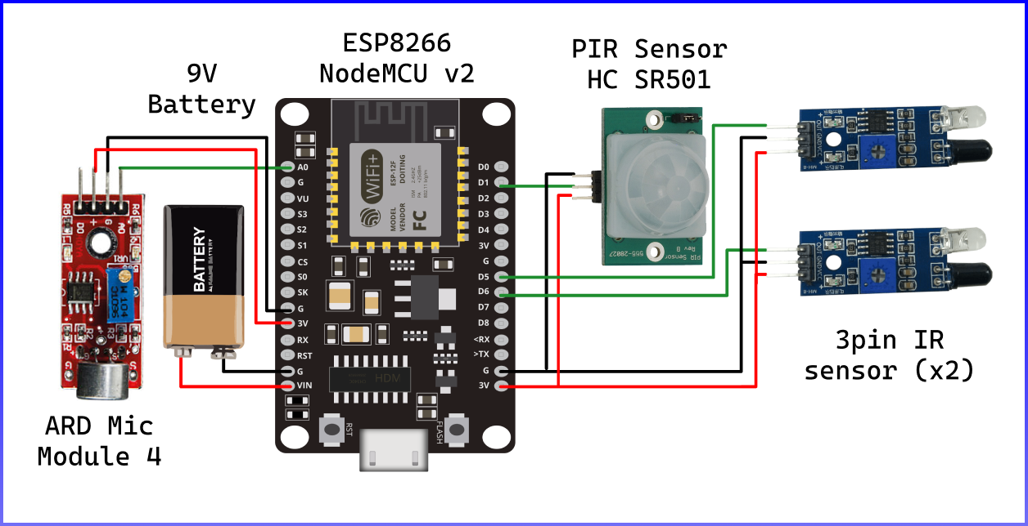
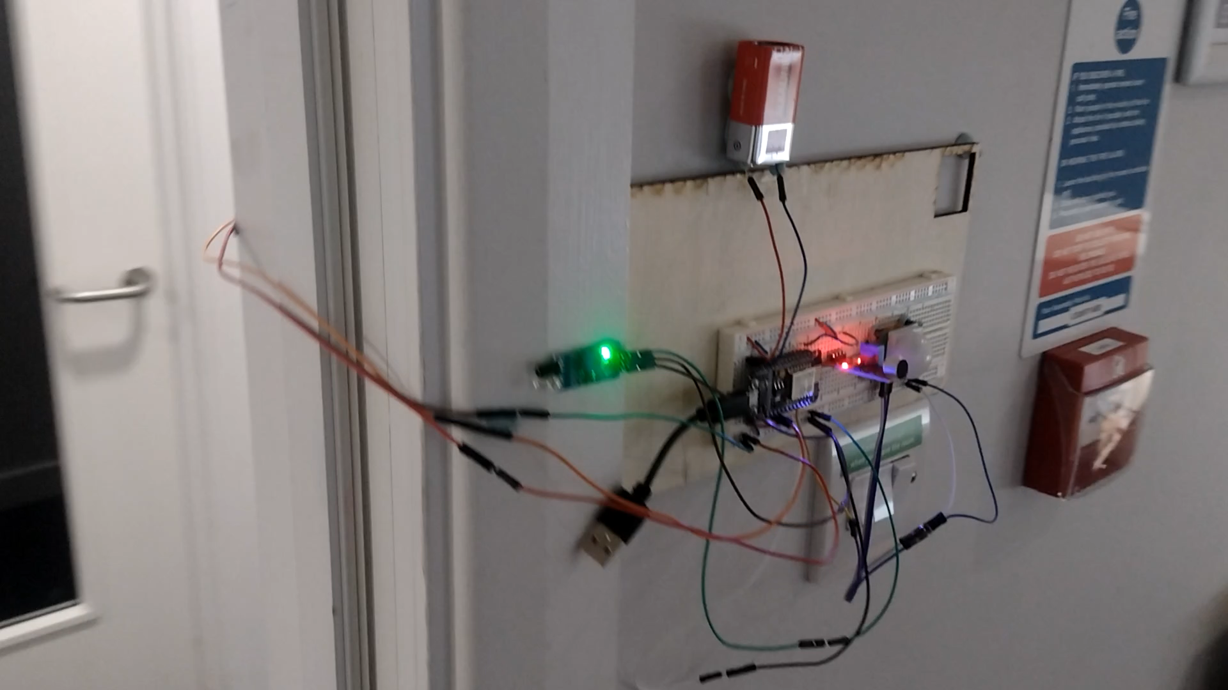
Hardware components

Slide 6
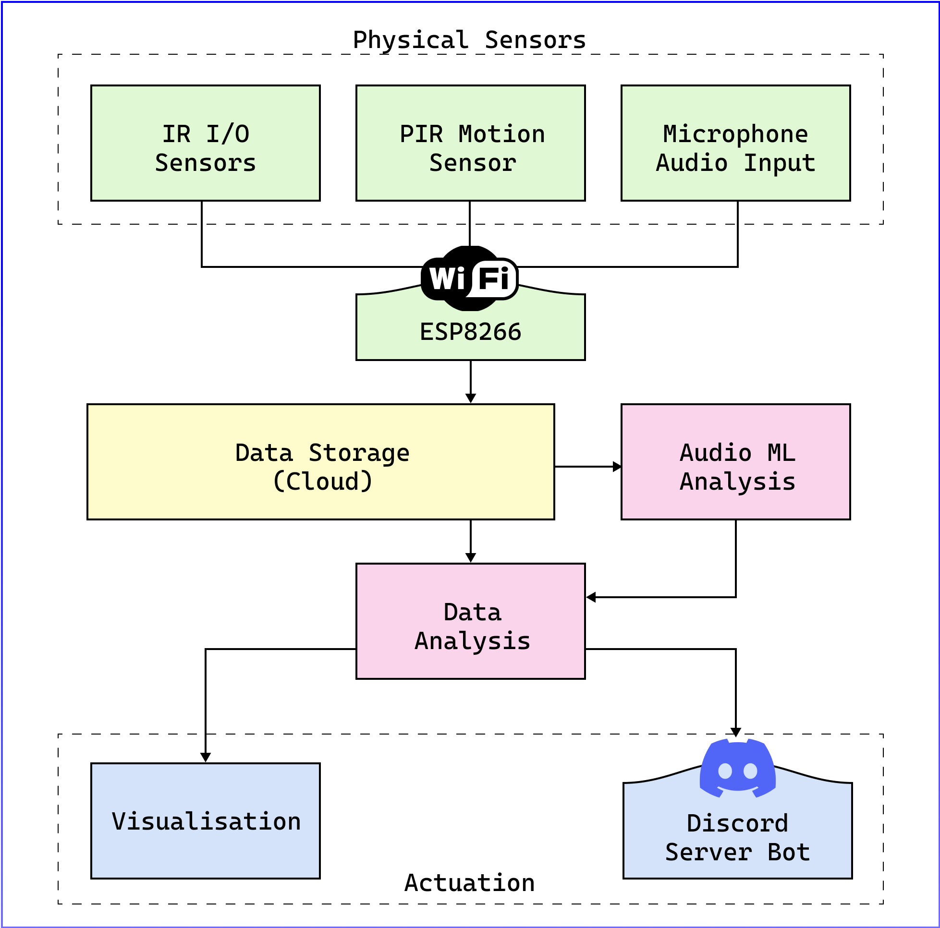
End-to-end system characteristics
Unable to achieve due to issues with ADC Sampling
MongoDB
Discord.JS
ThingSpeak

Slide 7
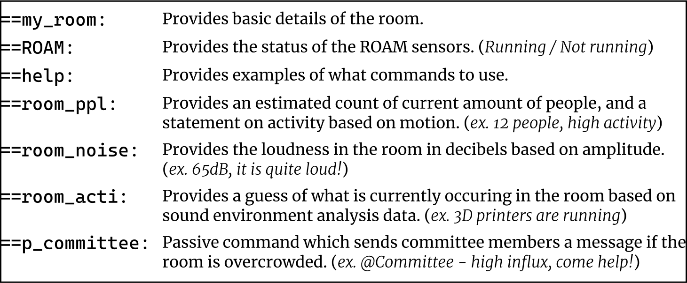
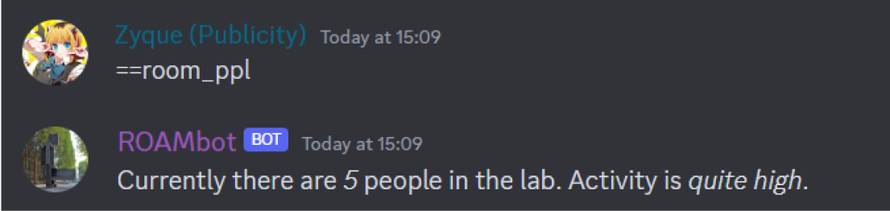
Actuation: discord bot

